Slide 1
ARM – An Understanding and More.
Shriram K Vasudevan
Dept. of CSE, Amrita University, Coimbatore, India.
Kv_shriram@cb.amrita.edu
Ph: 89399 18562
Source: inspired by various materials and it is a consolidation! Materials available are plenty, choosing the right one is the toughest task! ☺

Slide 2
Agenda.
Features and Basics
Architecture.
Programming Model.
Instruction Set.
Thumb Mode.
Few Sample Codes.

Slide 3
What is ARM?
ARM processor is basically a 32 bit processor, meant particularly for high end applications which involve more complex computation and calculations.
ARM processor was first developed at “ACORN computer Limited” of Cambridge, England between 1983 and 1985 just after 1980 when the concept of RISC was introduced at Stanford and Berkley. (ARM – Acron RISC Machine)
ARM specializes in the concept of ARM core, which they have licensed to number of other manufacturers to make a variety of chips around the same processor core. (Means, I tell you how to make, you make it in your name!)

Slide 4
Contd.,
So, now the focus is not on family of processors, but conceptually a CPU architecture which may figure in number of different chips intended for embedded applications.
The ARM is based on RISC architecture, but it is not a purely RISC architecture because it has been enhanced to meet the requirement of embedded applications. → Versatility!
The requirements for embedded applications are basically high code density, low power consumption as well as low and smaller silicon footprint. Architecturally ARM satisfies various conditions and properties of RISC processors as well.

Slide 5
Features
ARM processor has a large uniform register file.
It is basically a LOAD-STORE architecture, where data processing operations are only between registers and does not involve any memory operations.
It is a 32 bit processor and also has variants of 16 bit and 8 bit architectures.
So, there are 16 bit and 8 bit variants embedded into a 32 bit processor.
We will enumerate about 16 bit and 8 bit variants also called as THUMB and Jazelle architecture.
ARM has got a very good speed Vs power consumption ratio and high code density as required by embedded applications
It has got barrel shifter in the data path, which can maximize the hardware usage available on the chip.
It has also got auto increment and auto decrement addressing modes to optimize program loops; this is not very common with RISC processor. Also ARM supports LOAD and STORE of multiple data elements through a single instruction.
ARM has also got a feature named ‘conditional execution’, where an instruction gets executed only when a condition is being met, which maximizes the execution throughput.

Slide 6
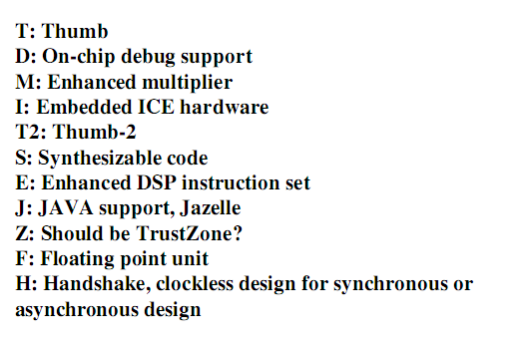
See this labels.

Slide 7
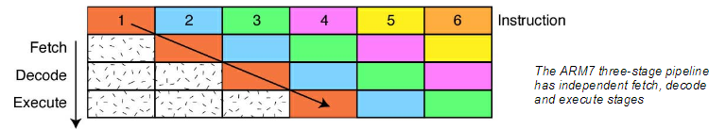
The Pipeline
At the heart of the ARM7 CPU is the instruction pipeline. The pipeline is used to process instructions taken from the program store.
On the ARM 7 a three-stage pipeline is used.

Slide 8
Contd.,
A three-stage pipeline is the simplest form of pipeline and does not suffer from the kind of hazards such as read-before-write seen in pipelines with more stages.
The pipeline has hardware independent stages that execute one instruction while decoding a second and fetching a third.
The pipeline speeds up the throughput of CPU instructions so effectively that most ARM instructions can be executed in a single cycle.
The pipeline works most efficiently on linear code. As soon as a branch is encountered, the pipeline is flushed and must be refilled before full execution speed can be resumed. (Very Essential ☺ )
As we shall see, the ARM instruction set has some interesting features which help smooth out small jumps in your code in order to get the best flow of code through the pipeline.
As the pipeline is part of the CPU, the programmer does not have any exposure to it.
Notes:
A barrel shifter is a digital circuit that can shift a data word by a specified number of bits without the use of any sequential logic, only pure combinatorial logic. ... A barrel shifter is often used to shift and rotate n-bits in modern microprocessors, typically within a single clock cycle.

Slide 9
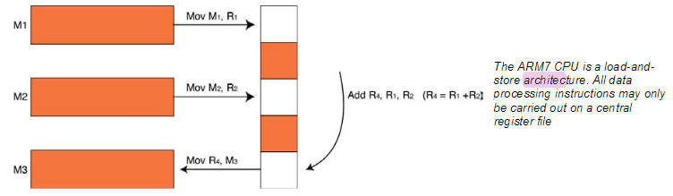
Programmers Model – Register Architecture
The ARM7 is a load-and-store architecture, so in order to perform any data processing instructions the data has first to be moved from the memory store into a central set of registers, the data processing instruction has to be executed and then the data is stored back into memory. (This is Load and Store, Recollect the past)

Slide 10
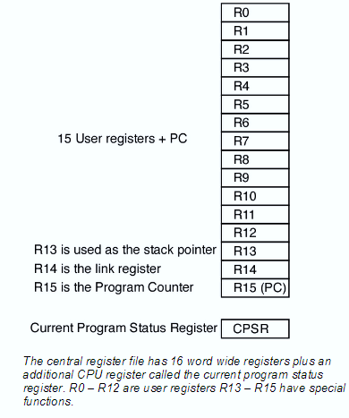
Contd.,
The central set of registers are a bank of 16 user registers R0 – R15. Each of these registers is 32 bits wide and R0 – R12 are user registers in that they do not have any specific other function. (Means, general purpose registers)
The Registers R13 – R15 do have special functions in the CPU.
R13 is used as the stack pointer (SP). (You know what it is!)

Slide 11
Contd.,
R14 is called the link register (LR).
When a call is made to a function the return address is automatically stored in the link register and is immediately available on return from the function.
This allows quick entry and return in to a ‘leaf’ function (a function that is not going to call further functions).
If the function is part of a branch (i.e. it is going to call other functions) then the link register must be preserved on the stack (R13). (Do you understand??)
Finally R15 is the program counter (PC).
Interestingly, many instructions can be performed on R13 - R15 as if they were standard user registers (But, don’t ever do this please!)
Notes:
A barrel shifter is a digital circuit that can shift a data word by a specified number of bits without the use of any sequential logic, only pure combinatorial logic. ... A barrel shifter is often used to shift and rotate n-bits in modern microprocessors, typically within a single clock cycle.

Slide 12
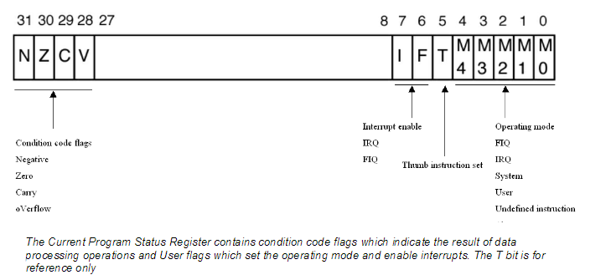
Current Program Status Register
In addition to the register bank there is an additional 32 bit wide register called the ‘current program status register’ (CPSR). The CPSR contains a number of flags which report and control the operation of the ARM7 CPU.

Slide 13
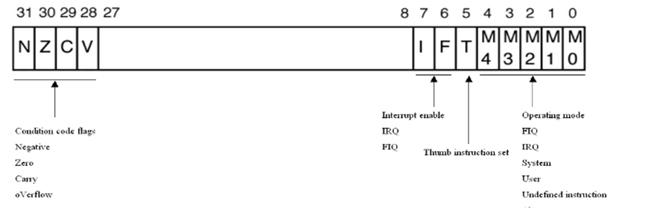
Contd.,
The top four bits of the CPSR contain the condition codes which are set by the CPU. (Flags)
The lowest eight bits in the CPSR contain flags which may be set or cleared by the application code.
Bits 7 and 8 are the I and F bits. These bits are used to enable and disable the two interrupt sources which are external to the ARM7 PU. You should be careful when programming these two bits because in order to disable either interrupt source the bit must be set to ‘1’ not ‘0’ as you might expect. Bit 5 is the THUMB bit.

Slide 14
Contd.,
The ARM7 CPU is capable of executing two instruction sets; the ARM instruction set which is 32 bits wide and the THUMB instruction set which is 16 bits wide. (Jazelle is also there. We are not worried!)
Consequently the T bit reports which instruction set is being executed. (Refer the label slide).
Your code should not try to set or clear this bit to switch between instruction sets. (Means, instructions shall be different for different modes)
The last five bits are the mode bits.
The ARM7 has 7 different operating modes. (We shall see this later)
Your application code will normally run in the user mode with access to the register bank R0 – R15 and the CPSR as already discussed.
However, in response to an exception such as an interrupt, memory error or software interrupt instruction the processor will change modes.
When this happens the registers R0 – R12 and R15 remain the same but R13 (LR ) and R14 (SP) are replaced by a new pair of registers unique to that mode. This means that each mode has its own stack and link register. (Understand this, please, this will help in resuming operation)
In addition, the fast interrupt mode (FIQ) has duplicate registers for R7 – R12.

Slide 15
Contd.,
Each of the modes except user mode has an additional register called the “saved program status register”.
If your application is running in user mode when an exception occurs the mode will change and the current contents of the CPSR will be saved into the SPSR. (Context saving is this, folks)

Slide 16
Register Set and View
Current Visible Registers
Current Visible Registers
Current Visible Registers
Current Visible Registers
Current Visible Registers
Current Visible Registers
r0
r0
r0
r0
r0
r0
Abort Mode
r0
SVC Mode
Undef Mode
FIQ Mode
User Mode
IRQ Mode
r1
r1
r1
r1
r1
r1
r1
r2
r2
r2
r2
r2
r2
r2
Banked out Registers
Banked out Registers
Banked out Registers
Banked out Registers
Banked out Registers
r3
Banked out Registers
r3
r3
r3
r3
r3
r3
r4
r4
r4
r4
r4
r4
r4
r5
r5
r5
r5
r5
r5
r5
User
User
User
User
User
FIQ
FIQ
FIQ
FIQ
FIQ
FIQ
IRQ
IRQ
IRQ
IRQ
IRQ
IRQ
SVC
SVC
SVC
SVC
SVC
SVC
Undef
Undef
Undef
Undef
Undef
Undef
Abort
Abort
Abort
Abort
Abort
r6
Abort
r6
r6
r6
r6
r6
r6
r7
r7
r7
r7
r7
r7
r7
r8
r8
r8
r8
r8
r8
r8
r8
r8
r8
r8
r8
r8
r8
r9
r9
r9
r9
r9
r9
r9
r9
r9
r9
r9
r9
r9
r9
r10
r10
r10
r10
r10
r10
r10
r10
r10
r10
r10
r10
r10
r10
r11
r11
r11
r11
r11
r11
r11
r11
r11
r11
r11
r11
r11
r11
r12
r12
r12
r12
r12
r12
r12
r12
r12
r12
r12
r12
r12
r12
r13 (sp)
r13 (sp)
r13 (sp)
r13 (sp)
r13 (sp)
r13 (sp)
r13 (sp)
r13 (sp)
r13 (sp)
r13 (sp)
r13 (sp)
r13 (sp)
r13 (sp)
r13 (sp)
r13 (sp)
r13 (sp)
r13 (sp)
r13 (sp)
r13 (sp)
r13 (sp)
r13 (sp)
r13 (sp)
r13 (sp)
r13 (sp)
r13 (sp)
r13 (sp)
r13 (sp)
r13 (sp)
r13 (sp)
r13 (sp)
r13 (sp)
r13 (sp)
r13 (sp)
r13 (sp)
r13 (sp)
r13 (sp)
r13 (sp)
r13 (sp)
r13 (sp)
r13 (sp)
r13 (sp)
r13 (sp)
r14 (lr)
r14 (lr)
r14 (lr)
r14 (lr)
r14 (lr)
r14 (lr)
r14 (lr)
r14 (lr)
r14 (lr)
r14 (lr)
r14 (lr)
r14 (lr)
r14 (lr)
r14 (lr)
r14 (lr)
r14 (lr)
r14 (lr)
r14 (lr)
r14 (lr)
r14 (lr)
r14 (lr)
r14 (lr)
r14 (lr)
r14 (lr)
r14 (lr)
r14 (lr)
r14 (lr)
r14 (lr)
r14 (lr)
r14 (lr)
r14 (lr)
r14 (lr)
r14 (lr)
r14 (lr)
r14 (lr)
r14 (lr)
r14 (lr)
r14 (lr)
r14 (lr)
r14 (lr)
r14 (lr)
r14 (lr)
r15 (pc)
r15 (pc)
r15 (pc)
r15 (pc)
r15 (pc)
r15 (pc)
r15 (pc)
cpsr
cpsr
cpsr
cpsr
cpsr
cpsr
cpsr
spsr
spsr
spsr
spsr
spsr
spsr
spsr
spsr
spsr
spsr
spsr
spsr
spsr
spsr
spsr
spsr
spsr
spsr
spsr
spsr
spsr
spsr
spsr
spsr
spsr
spsr
spsr
spsr
spsr
spsr
spsr
spsr
spsr
spsr
spsr
Notes:
This animated slide shows the way that the banking of registers works. On the left the currently visible set of registers are shown for a particular mode.
On the right are the registers that are banked out whilst in that mode.
Each key press will switch mode:
user -> FIQ ->user -> IRQ -> user ->SVC -> User -> Undef -> User -> Abort and then back to user.
The following slide then shows this in a more static way that is more useful for reference

Slide 17
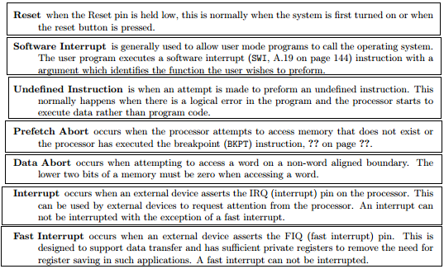
Contd.,
User : unprivileged mode under which most tasks run
FIQ : entered when a high priority (fast) interrupt is raised
IRQ : entered when a low priority (normal) interrupt is raised
Supervisor : entered on reset and when a Software Interrupt
instruction is executed
Abort : used to handle memory access violations
Undef : used to handle undefined instructions
System : privileged mode using the same registers as user mode

Slide 18
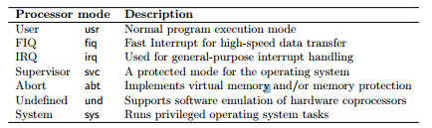
Contd.,
All modes other than USER are privileged.
These have full access to system resources and can move freely.
Exception modes are also there. (5, see in next slide). Happens when there is an exception.
System mode – Like user mode. But, privileged.
For operating system tasks.
Does not require additional registers, but needs system resources.
So, made a privileged mode.

Slide 19
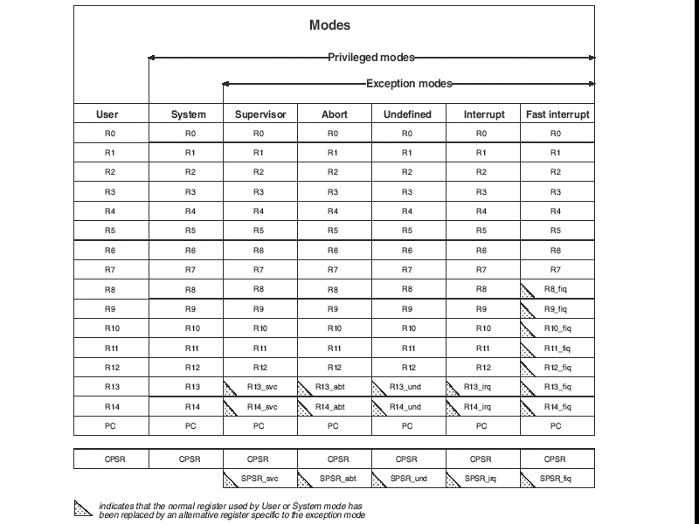
This will clarify.

Slide 20
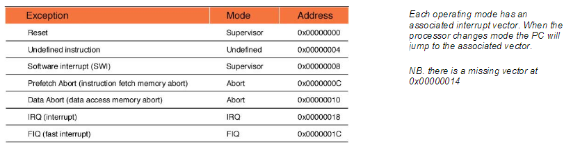
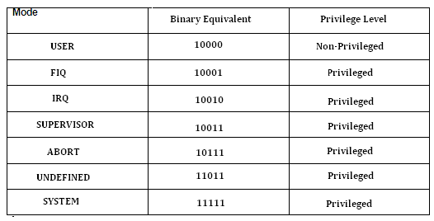
Exception Modes
When an exception occurs, the CPU will change modes and the PC be forced to an exception vector. The vector table starts from address zero with the reset vector and then has an exception vector every four bytes.

Slide 21
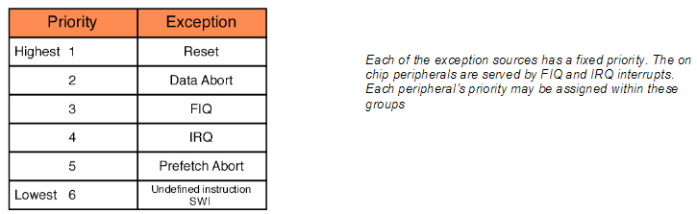
Contd.,
There is a gap in the vector table because there is a missing vector at 0x00000014.
This location was used on an earlier ARM architecture and has been preserved on ARM7 to ensure software compatibility between different ARM architectures.

Slide 22
Basic ARM Architecture
Any architecture is not only characterized by its data path, but also by its control path.
This data path is organized in such a way that the operands are not directly fetched from memory, and a basic feature of RISC is that operands get fetched from registers and not from memory.
Instructions typically use two source registers and single result/destination register.
The more interesting facts are the presence of the ’barrel shifter’ and the ‘increment/decrement’ logic.
The barrel shifter on the data path can preprocess the data before it enters the ALU.
It is basically a combinational circuit that can shift a data bit to the left or to the right by an arbitrary number of positions in the same cycle itself. (This feature is not supported in many of the other processors)

Slide 23
Contd.,
In classical shift register, the number of shifts requires an equivalent number of clocks because, the shifting takes place based on clocks.
In barrel shifter, Combinational circuit is used, where the shifting takes place in a single attempt itself.
In fact, the shift takes place in the same instruction itself. This is a very basic enhancement present in the ARM data path.
The other interesting feature is the increment and decrement logic which can operate on the registers that are independent of the ALU.
This facilitates the implementation of auto-increment and auto-decrement features in the ARM, where it is used for movement of blocks of data between the memory and registers.

Slide 24
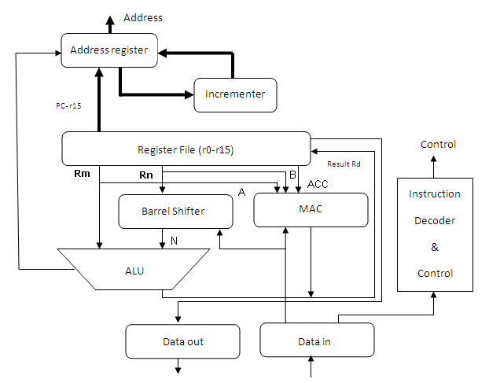
ARM organization core data flow model
The arrows represent the direction of data flow, and the lines represent the buses and the boxes represent either a storage unit or an operation unit.

Slide 25
ARM organization core data flow model
Instruction decoder:
It decodes the instruction before execution is carried out.
There are three kinds of instruction set supported in ARM core.
They can be ARM instruction set; Jazelle Instruction set and THUMB instruction set.
With the CPSR one can set the operation state and accordingly instruction set can be selected.

Slide 26
Load and Store architecture:
ARM falls in the RISC category which follows the Load and Store architecture.
Means, with Load and Store architecture in place, registers will be mandatory for processing to be carried out.
Without registers one cannot do any sort of operation with ARM core.
ARM has 2 source registers Rm and Rn and one destination register which carries the result. The destination register is named as Rd.
A and B are the two buses that will help in reading the source operands.
Rm and Rn values will be fetched from the buses A and B and computation will be carried out in the ALU or MAC (Multiplication and Accumulate unit). Address registers are used to hold the address and address bus will facilitate the storage action.
Barrel shifter is a kind of support which is very useful in association with ALU for expression evaluation and address calculation.
After going through the steps and sequences the result will be moved to the Register Rd.
A barrel shifter is a digital circuit that can shift a data word by a specified number of bits without the use of any sequential logic, only pure combinatorial logic. ... A barrel shifter is often used to shift and rotate n-bits in modern microprocessors, typically within a single clock cycle.

Slide 27
3-stage pipeline ARM organization
Fetch:
The instruction is fetched from memory and placed in the instruction pipeline.
Decode:
The instruction is decoded and the datapath control signals prepared for the next cycle. In this stage the instruction 'owns' the decode logic but not the datapath.
Execute:
The instruction 'owns' the datapath; the register bank is read, an operand shifted, the ALU result generated and written back into a destination register
At any one time, three different instructions may occupy each of these stages, so the hardware in each stage has to be capable of independent operation

Slide 28
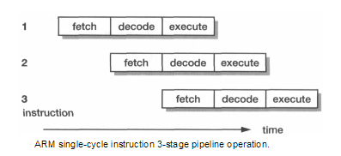
Contd.,
When the processor is executing simple data processing instructions the pipeline enables one instruction to be completed every clock cycle.
An individual instruction takes three clock cycles to complete, so it has a three-cycle latency, but the through-put is one instruction per cycle.

Slide 29
5 stage pipeline
Higher performance ARM cores employ a 5-stage pipeline and have separate instruction and data memories.
Breaking instruction execution down into five components rather than three reduces the maximum work which must be completed in a clock cycle, and hence allows a higher clock frequency to be used (provided that other system components, and particularly the instruction memory, are also redesigned to operate at this higher clock rate).

Slide 30
Contd.,
Fetch: the instruction is fetched from memory and placed in the instruction pipeline.
Decode: the instruction is decoded and register operands read from the register file. There are three operand read ports in the register file, so most ARM instructions can source all their operands in one cycle.
Execute: an operand is shifted and the ALU result generated. If the instruction is a load or store the memory address is computed in the ALU.
Buffer/data: data memory is accessed if required. Otherwise the ALU result is simply buffered for one clock cycle to give the same pipeline flow for all instructions.
Write-back: the results generated by the instruction are written back to the register file, including any data loaded from memory.

Slide 31
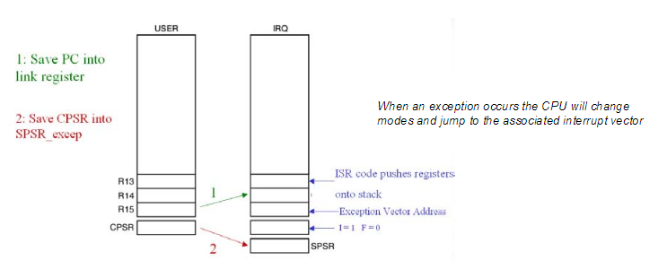
What happens when an exception occurs?
When an exception occurs, for example an IRQ exception, the following actions are taken:
First the address of the next instruction to be executed (PC + 4) is saved into the link register

Slide 32
Contd.,
Then the CPSR is copied into the SPSR of the exception mode that is about to be entered (i.e. SPSR_irq)
The PC is then filled with the address of the exception mode interrupt vector. In the case of the IRQ mode this is 0x00000018 (Refer the table shown earlier.)

Slide 33
Contd.,
At the same time the mode is changed to IRQ mode, which causes R13 and R14 to be replaced by the IRQ R13 and R14 registers.
Once your code has finished processing the exception it must return back to the user mode and continue where it left off.
However the ARM instruction set does not contain a return” or “return from interrupt” instruction so manipulating the PC must be done by regular instructions.

Slide 34
Contd.,
The situation is further complicated by there being a number of different return cases. (Makes life further difficult)
Let us consider three cases! All are very interesting to look into! ☺

Slide 35
Case : 1
Consider the SWI instruction.
In this case the SWI instruction is executed, the address of the next instruction to be executed is stored in the Link register and the exception is processed.
In order to return from the exception all that is necessary is to move the contents of the link register into the PC and processing can continue.
However in order to make the CPU switch modes back to user mode, a modified version of the move instruction is used and this is called MOVS (more about this later).
Hence for a software interrupt the return instruction is
MOVS R15,R14 ; Move Link register into the PC and switch modes.

Slide 36
Case: 2
Consider the FIQ and IRQ instructions, when an exception occurs the current instruction being executed is discarded and the exception is entered.
When the code returns from the exception the link register contains the address of the discarded instruction plus four.
In order to resume processing at the correct point we need to roll back the value in the Link register by four.
In this case we use the subtract instruction to deduct four from the link register and store the results in the PC.
As with the move instruction, there is a form of the subtract instruction which will also restore the operating mode. For an IRQ, FIQ or Prog Abort, the return instruction is:
SUBS R15, R14,#4

Slide 37
Case: 3
In the case of a data abort instruction, the exception will occur one instruction after execution of the instruction which caused the exception.
In this case we will ideally enter the data abort ISR, sort out the problem with the memory and return to reprocess the instruction that caused the exception. In this case we have to roll back the PC by two instructions i.e. the discarded instruction and the instruction that caused the exception.
In other words subtract eight from the link register and store the result in the PC. For a data abort exception the return instruction is
SUBS R15, R14,#8

Slide 38
Features of ARM – Apt here.
ARM processor has a large uniform register file.
It is basically a LOAD-STORE architecture, where data processing operations are only between registers and does not involve any memory operations.
It is a 32 bit processor and also has variants of 16 bit and 8 bit architectures.
So, there are 16 bit and 8 bit variants embedded into a 32 bit processor.
We will enumerate about 16 bit and 8 bit variants also called as THUMB and Jazelle architecture.
ARM has got a very good speed Vs power consumption ratio and high code density as required by embedded applications
It has got barrel shifter in the data path, which can maximize the hardware usage available on the chip.
It has also got auto increment and auto decrement addressing modes to optimize program loops; this is not very common with RISC processor. Also ARM supports LOAD and STORE of multiple data elements through a single instruction.
ARM has also got a feature named ‘conditional execution’, where an instruction gets executed only when a condition is being met, which maximizes the execution throughput.

Slide 39
Conditional Execution – Remember this.
Most instruction sets only allow branches to be executed conditionally.
However by reusing the condition evaluation hardware, ARM effectively increases number of instructions.
All instructions contain a condition field which determines whether the CPU will execute them.
Non-executed instructions soak up 1 cycle.
Still have to complete cycle so as to allow fetching and decoding of following instructions.
This removes the need for many branches, which stall the pipeline (3 cycles to refill).
Allows very dense in-line code, without branches.
The Time penalty of not executing several conditional instructions is frequently less than overhead of the branch or subroutine call that would otherwise be needed.

Slide 40
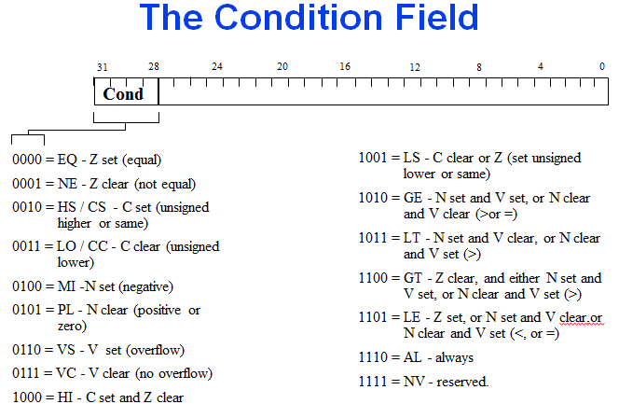
Condition Field.

Slide 41
Conditional Execution
To execute an instruction conditionally, simply postfix it with the appropriate condition:
For example an add instruction takes the form:
ADD r0,r1,r2 ; r0 = r1 + r2 (ADDAL)
To execute this only if the zero flag is set:
ADDEQ r0,r1,r2 ; If zero flag set then… ; ... r0 = r1 + r2
By default, data processing operations do not affect the condition flags (apart from the comparisons where this is the only effect). To cause the condition flags to be updated, the S bit of the instruction needs to be set by postfixing the instruction (and any condition code) with an “S”.
For example to add two numbers and set the condition flags:
ADDS r0,r1,r2 ; r0 = r1 + r2 ; ... and set flags

Slide 42
ARM Instruction Set / Thumb Instruction Set.

Slide 43
Quick Analysis of Instruction Set. Data Processing Instructions.
Largest family of ARM instructions, all sharing the same instruction format.
Contains:
Arithmetic operations
Comparisons (no results - just set condition codes)
Logical operations
Data movement between registers
Remember, this is a load / store architecture
These instruction only work on registers, NOT memory.
They each perform a specific operation on one or two operands.
First operand always a register - Rn
Second operand sent to the ALU via barrel shifter.

Slide 44
Arithmetic Instructions.
Operations are:
ADD operand1 + operand2
ADC operand1 + operand2 + carry
SUB operand1 - operand2
SBC operand1 - operand2 + carry -1
RSB operand2 - operand1
RSC operand2 - operand1 + carry - 1
Syntax:
<Operation>{<cond>}{S} Rd, Rn, Operand2
Examples
ADD r0, r1, r2
SUBGT r3, r3, #1
RSBLES r4, r5, #5

Slide 45
Comparisons
The only effect of the comparisons is to
UPDATE THE CONDITION FLAGS. Thus no need to set S bit.
Operations are:
CMP operand1 - operand2, but result not written
CMN operand1 + operand2, but result not written
TST operand1 AND operand2, but result not written
TEQ operand1 EOR operand2, but result not written
Syntax:
<Operation>{<cond>} Rn, Operand2
Examples:
CMP r0, r1
TSTEQ r2, #5

Slide 46
Data Movement
Operations are:
MOV operand2
MVN NOT operand2
Note that these make no use of operand1.
Syntax:
<Operation>{<cond>}{S} Rd, Operand2
Examples:
MOV r0, r1
MOVS r2, #10
MVNEQ r1,#0

Slide 47
Multiplication Instructions
The Basic ARM provides two multiplication instructions.
Multiply
MUL{<cond>}{S} Rd, Rm, Rs ; Rd = Rm * Rs
Multiply Accumulate - does addition for free
MLA{<cond>}{S} Rd, Rm, Rs,Rn ; Rd = (Rm * Rs) + Rn
Restrictions on use:
Rd and Rm cannot be the same register
Can be avoid by swapping Rm and Rs around. This works because multiplication is commutative.
Cannot use PC.
These will be picked up by the assembler if overlooked.
Operands can be considered signed or unsigned
Up to user to interpret correctly.

Slide 48
Load Store
The ARM is a Load / Store Architecture:
Does not support memory to memory data processing operations.
Must move data values into registers before using them.
This might sound inefficient, but in practice isn’t:
Load data values from memory into registers.
Process data in registers using a number of data processing instructions which are not slowed down by memory access.
Store results from registers out to memory.
The ARM has three sets of instructions which interact with main memory. These are:
Single register data transfer (LDR / STR).
Block data transfer (LDM/STM).
Single Data Swap (SWP).

Slide 49
Software Support
Download Keil from website. Select ARM core.
It will ask you to register. Register, download and install. It is easy.

Slide 50
Remember this.
There must be an ENTRY directive. This tells the location of the first executable instruction.
AREA = PROGRAM / DATA / OR ANYTHING!
END directive is must to show the code is getting completed there.
ARM can deal directly with 32 bit instructions as you all know.
It is possible to have a halfword by the use of DCW directive. To ensure consistency one should use ALIGN directive as shown in the examples.

Slide 51
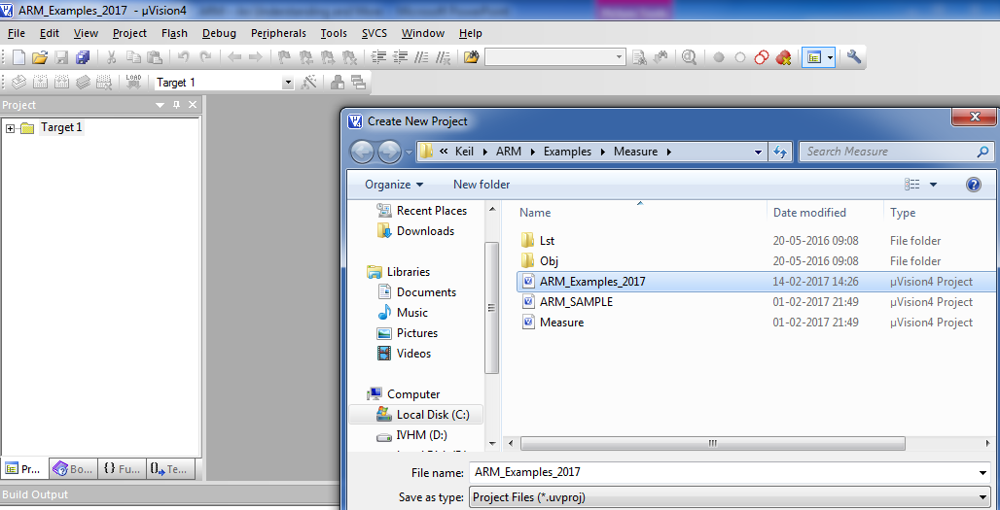
How to use Keil?

Slide 52
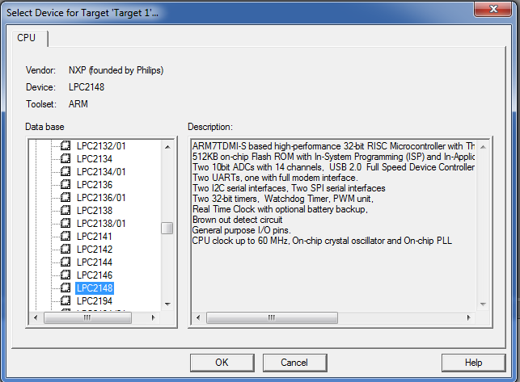
Select NXP – Philips – LPC2148

Slide 53
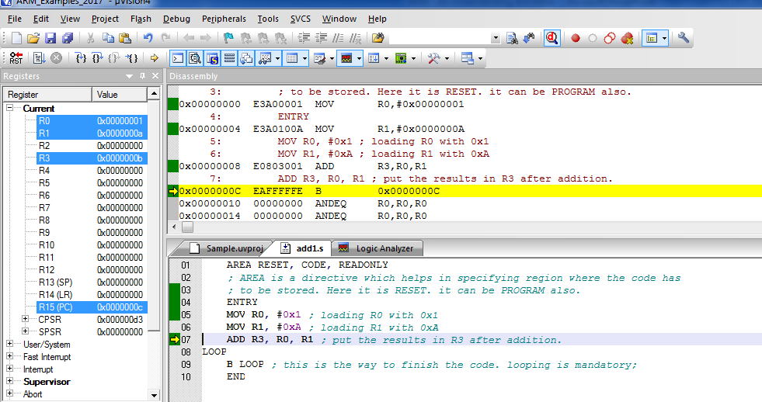
Simple addition with ARM mode instruction

Slide 54
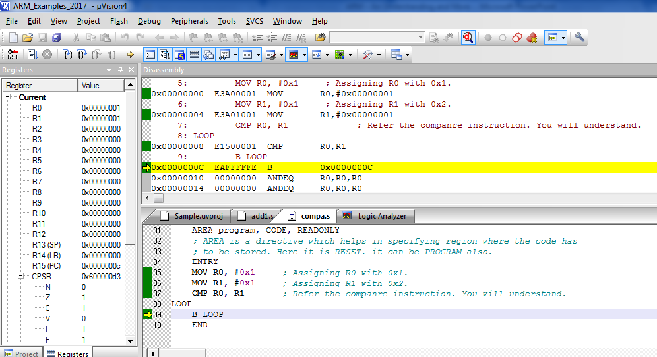
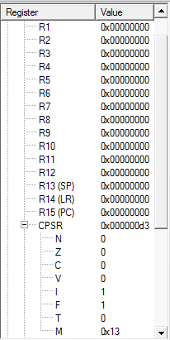
Compare Using ARM Instruction
SWI &11 can be
Used instead of
loop

Slide 55
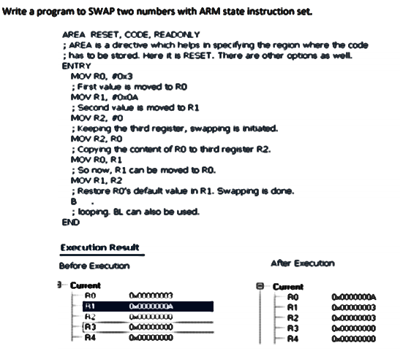
Swapping two numbers with ARM.

Slide 56
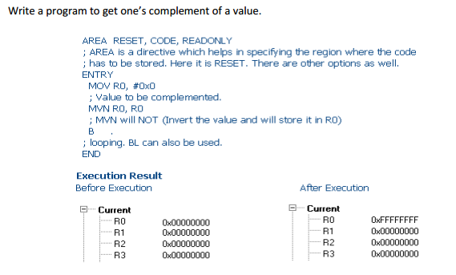
One’s complement

Slide 57
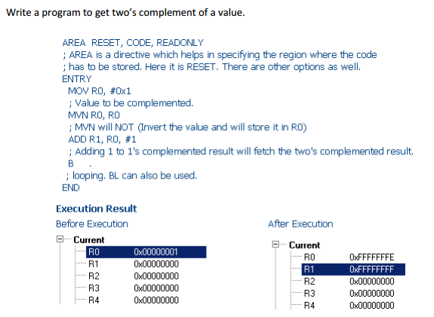
Two’s complement

Slide 58
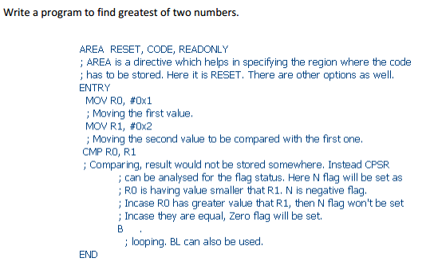
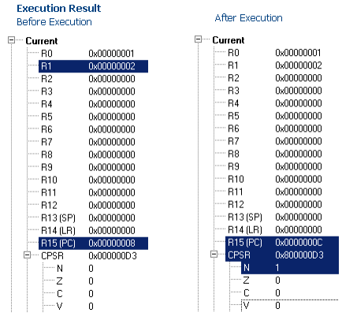
Greatest of 2 numbers

Slide 59

16 bit operation in ARM
; 16 bit data transfer happens here.
TTL 16bitdatatransfer
AREA program, CODE, READONLY
; AREA is a directive which helps in specifying region where the code has
; to be stored. Here it is RESET. it can be PROGRAM also.
ENTRY
Main
LDRB R1, Value ; Loading the value to be moved.
STR R1, Result ; Store it back.
SWI &11 ; Software Interrupt instead of loop option seen earlier.
Value DCW &C123
ALIGN ; This will support 16 bit execution in ARM mode.
Result DCW 0 ; Storage
END

Slide 60
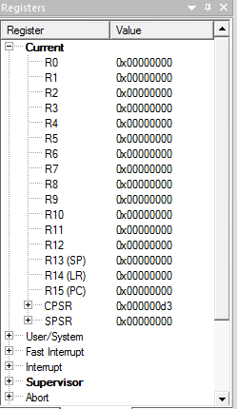
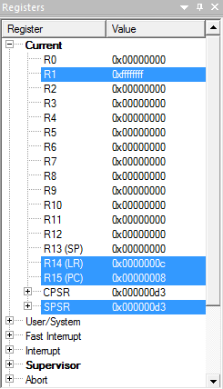
A Simple One’s complement in a different way.
; Ones complement Example.
TTL onescomplement
AREA program, CODE, READONLY
; AREA is a directive which helps in specifying region where the code has
; to be stored. Here it is RESET. it can be PROGRAM also.
ENTRY
Main
LDRB R1, Value ; Loading the value to be complemented.
MVN R1, R1 ; See the way I used R1 and R1. MVN is NOT.
SWI &11 ; Software Interrupt instead of loop option seen earlier.
Value DCW &0000
ALIGN ; This will support 16 bit execution in ARM mode.
END
Before Execution
After Execution

Slide 61
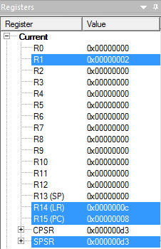
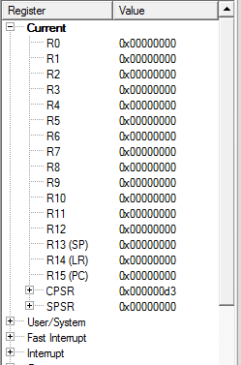
Shift Left One Bit.
; Shift Left One Bit!
TTL shift left one bit
AREA RESET, CODE, READONLY
; AREA is a directive which helps in specifying region where the code
; has to be stored. Here it is RESET. it can be PROGRAM also.
ENTRY
Main
LDRB R1, Value ; Loading the value to be complemented.
MOV R1, R1, LSL#0X1 ; one bit shift.
SWI &11
Value DCD &0001
END
Before Execution
After Execution

Slide 62
Getting into Thumb Mode. (No great change, it is a mode, that’s all! )
Core has two execution states ARM and Thumb;
Thumb is a compressed and 16 bit representation of a subset of the ARM instruction set.
Like ARM, Thumb also uses load store architecture for data processing, data transfer and control flow instructions.
The standard chip that includes the Thumb instruction set is the ARM7TDMI where "T" specifies Thumb. (Remember this, we saw this in CPSR ;))

Slide 63
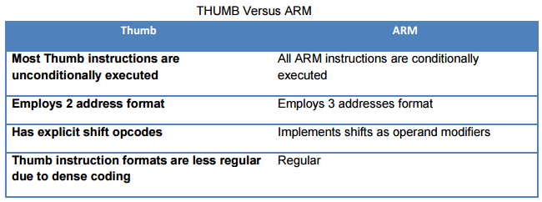
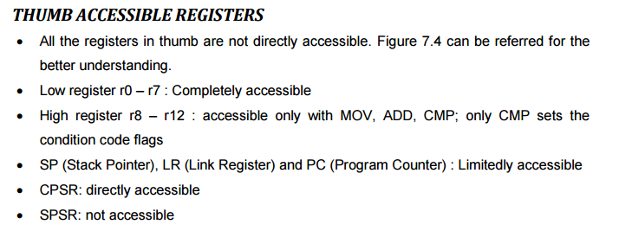
Contd.,

Slide 64
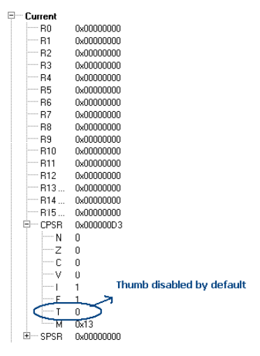
How to set thumb state?
D3 is the default value for the CPSR as shown in the below. So by default one can observe that the Thumb state is disabled. To get it enabled, as already discussed CPSR should be accessed and T bit should be set.

Slide 65
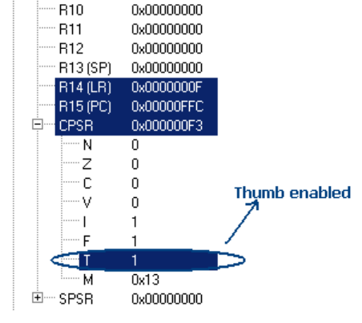
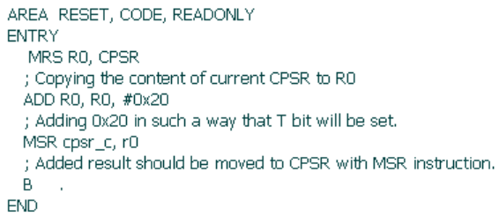
Contd.,
Setting the T bit can be done by adding 0x20 to the D3. It will then set the T bit and eventually the THUMB mode will be set

Slide 66
Try these all with ARM.
1. Write a program to find greatest of three numbers.
2. Write a program to SWAP two values without using the third variable.
3. Write a simple code to find out if a number is prime or not.
4. Write a program to SWAP upper and lower nibbles of a number.
5. Write a program to disassemble a value. E.g. 54H to 05H and 04H.
6. Write a program to convert ASCII value to BINARY.
7. Write a program to convert HEXADECIMAL to BINARY.
8. Factorial of a given number.
9. Fibonacci series.
10. Prime number or not.
11. Sorting the numbers in a series.

Slide 67
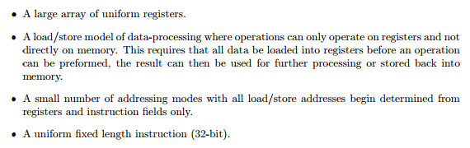
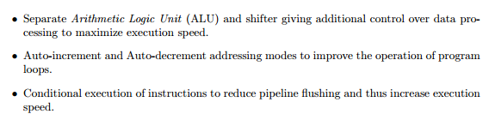

Recollect all these! – Points to remember.

Slide 68
Memory Management in ARM
Microprocessors are expected to execute instructions at a very high rate. (Compare 8085 with ARM!!)
This would be possible when you have sufficient memory support. (Means, how important it is to have bigger RAM in your phone)
Not only bigger, i.e. large, but also, it should be faster! ☺
If small, well, it cannot hold all the contents.
If slow, no use in holding all the contents (Because, processor would not get the instructions in time to process)

Slide 69
Contd.,
Here comes the challenge!
Larger the memory is, slower it gets. (Obvious right)
So, it is not possible for someone to design a large memory which is also faster. (This is not possible!)
Here comes the possibility:
Combine a small, fast memory with large slow main memory (Possible!! Trust me)
Now, you get a feel as “large fast memory in hand with you”.
Let us name these now!
Small, Fast component == Cache (Will have the most frequently accessed instruction. Library table/rack is the example)
Here comes the terms temporal and spatial locality!

Slide 70
Contd.,
Suppose you were a student writing a term paper on important historical developments in computer hardware.
You are sitting at a desk in a library with a collection of books that you have pulled from the shelves and are examining.
You find that several of the important computers that you need to write about are described in the books you have, but there is nothing about the EDSAC.
Therefore, you go back to the shelves and look for an additional book. You find a book on early British computers that covers EDSAC.
Once you have a good selection of books on the desk in front of you, there is a good probability that many of the topics you need can be found in them, and you may spend most of your time just using the books on the desk without going back to the shelves.
Having several books on the desk in front of you saves time compared to having only one book there and constantly having to go back to the shelves to return it and take out another.

Slide 71
Contd.,
The same principle allows us to create the illusion of a large memory that we can access as fast as a very small memory.
Just as you did not need to access all the books in the library at once with equal probability, a program does not access all of its code or data at once with equal probability.
Otherwise, it would be impossible to make most memory accesses fast and still have large memory in computers, just as it would be impossible for you to fit all the library books on your desk and still find what you wanted quickly

Slide 72
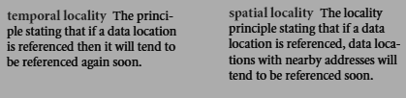
Contd.,
This principle of locality underlies both the way in which you did your work in the library and the way that programs operate.
The principle of locality states that programs access a relatively small portion of their address space at any instant of time, just as you accessed a very small portion of the library’s collection.
There are two different types of locality:
You brought out the book on early English computers to find out about EDSAC, you also noticed that there was another book shelved next to it about early mechanical computers, so you also brought back that book too and, later on, found something useful in that book.
Books on the same topic are shelved together in the library to increase spatial locality
If you recently brought a book to your desk to look at, you will probably need to look at it again soon

Slide 73
Contd.,
Just as accesses to books on the desk naturally exhibit locality, locality in programs arises from simple and natural program structures.
For example, most programs contain loops, so instructions and data are likely to be accessed repeatedly, showing high amounts of temporal locality.
Since instructions are normally accessed sequentially, programs show high spatial locality.
Accesses to data also exhibit a natural spatial locality. For example, accesses to elements of an array or a record will naturally have high degrees of spatial locality.

Slide 74
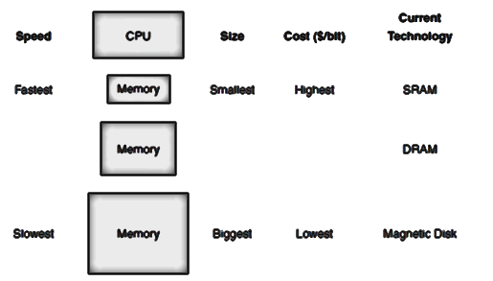
Memory size and speed
Let us look into the hierarchy!
Registers (Processor Registers) are on the top!! Means, they are on the top of the hierarchy!
Access time of few nanoseconds for the 32 registers we have seen here in ARM 7 architecture.
So, you need very less time to access the registers.
On chip cache up to 32 KB size with access time less than / eq to 10 nanoseconds.
Some systems (Desktop) may have few hundred KBs of second level off – chip cache. Access time remains few tens of Nano seconds.
We know about Main Memory (RAM) ranging from 512 MBs till GBs.
Finally, hard drive with the heavy storage capacity in the range of GBs and even to TBs with access time of few tens of Milli seconds.

Slide 75
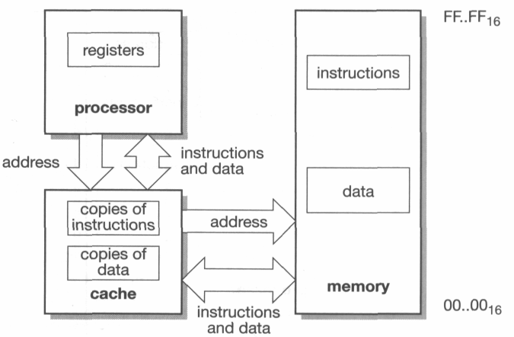
Unified and Harvard caches
Caches can be built in many ways. At the highest level a processor can have one of he following two organizations:
A unified cache.
This is a single cache for both instructions and data.
Separate instruction and data caches
This organization is sometimes called a modified Harvard architecture. (This makes load / store in one cycle)

Slide 76



Cache Performance Metrics
If the data requested by the processor appears in some block in the upper level, this is called a hit (analogous to your finding the information in one of the books on your desk).
If the data is not found in the upper level, the request is called a miss.
The lower level in the hierarchy is then accessed to retrieve the block containing the requested data.
(Continuing our analogy, you go from your desk to the shelves to find the desired book.)

Slide 77
Cache organization
Since a cache holds a dynamically varying selection of items from main memory, it must have storage for both the data and the address at which the data is stored in main memory. (remember this!)
Cache is a safe place for hiding or storing things – Says some dictionary.
Library example : Desk is also safe!! Books remain safe in the table as well! ☺
We begin by looking at a very simple cache in which the processor requests are each one word and the blocks also consist of a single word.

Slide 78
Contd.,
Figure RHS shows such a simple cache, before and after requesting a data item that is not initially in the cache.
Before the request, the cache contains a collection of recent references X1, X2, . . . , Xn – 1, and the processor requests a word Xn that is not in the cache.
This request results in a miss, and the word Xn is brought from memory into cache.
This reference causes a miss that forces the cache to fetch Xn from memory and insert it into the cache.

Slide 79
Contd.,
There are two questions to answer:
How do we know if a data item is in the cache?
Moreover, if it is, how do we find it?
The answers to these two questions are related. If each word can go in exactly one place in the cache, then it is straightforward to find the word if it is in the cache.
The simplest way to assign a location in the cache for each word in memory is to assign the cache location based on the address of the word in memory.
This cache structure is called direct mapped, since each memory location is mapped directly to exactly one location in the cache. The typical mapping between addresses and cache locations for a direct-mapped cache is usually simple.

Slide 80
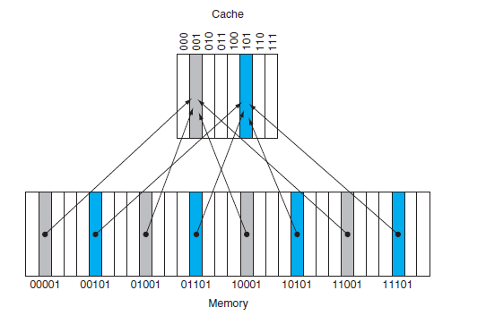
Contd.,
Because each cache location can contain the contents of a number of different memory locations, how do we know whether the data in the cache corresponds to a requested word?
That is, how do we know whether a requested word is in the cache or not?
We answer this question by adding a set of tags to the cache. The tags contain the address information required to identify whether a word in the cache corresponds to the requested word.
For example, Figure LHS shows how the memory addresses between 1ten (00001two) and 29ten (11101two) map to locations 1ten (001two) and 5ten (101two) in a direct-mapped cache of eight words.
This is called Direct Mapping!

Slide 81
Contd.,
The tag needs only to contain the upper portion of the address, corresponding to the bits that are not use as an index into the cache.
For example, (See RHS) we need only to have the upper 2 of the 5 address bits in the tag, since the lower 3-bit index field of the address selects the block.

Slide 82
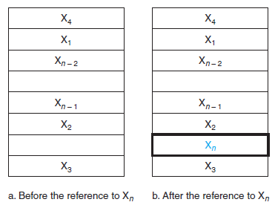
Contd.,
We also need a way to recognize that a cache block does not have valid information.
For instance, when a processor starts up, the cache does not have good data, and the tag fields will be meaningless.
Even after executing many instructions, some of the cache entries may still be empty, as in Figure RHS.
Thus, we need to know that the tag should be ignored for such entries.
The most common method is to add a valid bit to indicate whether an entry contains a valid address.
If the bit is not set, there cannot be a match for this block.

Slide 83
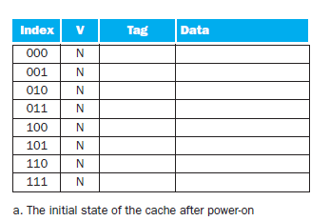
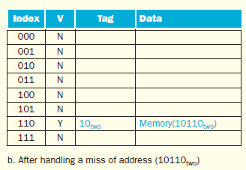
The cache is initially empty, with all valid bits (V entry in cache) turned off (N). The processor requests the following addresses: 10110two (miss), 11010two (miss), 10110two (hit), 11010two (hit), 10000two (miss), 00011two (miss), 10000two (hit), and 10010two (miss). The figures show the cache contents after each miss in the sequence has been handled. When address 10010two (18) is referenced, the entry for address 11010two (26) must be replaced, and a reference to 11010two will cause a subsequent miss. The tag field will contain only the upper portion of the address. The full address of a word contained in cache block i with tag field j for this cache is j ∞ 8 + i, or equivalently the concatenation of the tag field j and the index i. For example, in cache f above, index 010 has tag 10 and corresponds to address 10010.

Slide 84
Contd.,
So far, when we place a block in the cache, we have used a simple placement scheme: A block can go in exactly one place in the cache.
It is direct mapping! We have seen it already!
There is actually a whole range of schemes for placing blocks. At one extreme is direct mapped, where a block can be placed in exactly one location.
At the other extreme is a scheme where a block can be placed in any location in the cache.
Such a scheme is called fully associative because a block in memory may be associated with any entry in the cache.
To find a given block in a fully associative cache, all the entries in the cache must be searched because a block can be placed in any one.
To make the search practical, it is done in parallel with a comparator associated with each cache entry. These comparators significantly increase the hardware cost, effectively making fully associative placement practical only for caches with small numbers of blocks.

Slide 85
Contd.,
The middle range of designs between direct mapped and fully associative is called set associative.
In a set-associative cache, there are a fixed number of locations (at least two) where each block can be placed;
A set-associative cache with n locations for a block is called an n-way set-associative cache.
An n-way set-associative cache consists of a number of sets, each of which consists of n blocks. Each block in the memory maps to a unique set in the cache given by the index field, and a block can be placed in any element of that set.
Thus, a set associative placement combines direct-mapped placement and fully associative placement: a block is directly mapped into a set, and then all the blocks in the set are searched for a match.

Slide 86
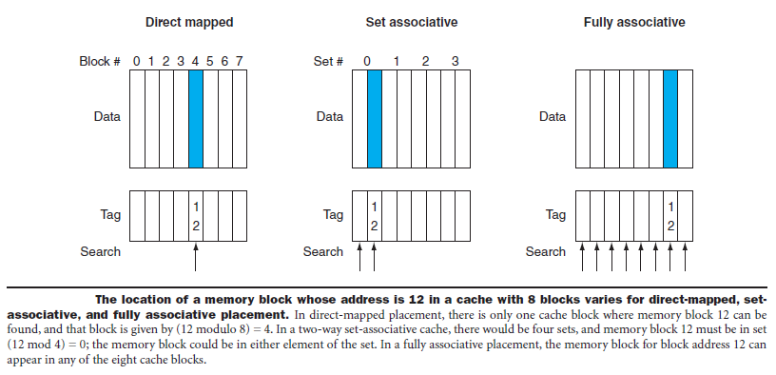
Contd.,
Remember that in a direct-mapped cache, the position of a memory block is given by
(Block number) modulo (Number of cache blocks)
In a set-associative cache, the set containing a memory block is given by
(Block number) modulo (Number of sets in the cache)

Slide 87
Periodical 2 portion is completed.
Shriram K Vasudevan

